Slide 1
Chapter 21: Windows 10

Slide 2
Chapter 21: Windows
History
Design Principles
System Components
Terminal Services and Fast User Switching
File System
Networking
Programmer Interface

Slide 3
Objectives
Explore the principles upon which Windows 10 is designed and the specific components involved in the system
Provide a detailed explanation of the Windows 10 file system
Illustrate the networking protocols supported in Windows 10
Describe the interface available in Windows 10 to system and application programmers
Describe the important algorithms implemented in Windows 10

Slide 4
History
In 1988, Microsoft decided to develop a “new technology” (NT) portable operating system that supported both the OS/2 and POSIX APIs
Originally, NT was supposed to use the OS/2 API as its native environment but during development NT was changed to use the Win32 API, reflecting the popularity of Windows 3.0.
Many versions of Windows along the way, XP, Vista, 7, 8, and now 10
Many older versions still in use, less secure, some unpatched

Slide 5
Windows 10
32- and 64-bit preemptive multitasking operating system for Intel microprocessors
Key goals for the system:
portability
security
POSIX compliance
multiprocessor support
extensibility
international support
compatibility with MS-DOS and MS-Windows applications
Uses a micro-kernel architecture
Several versions with different prices, for devices/laptops/desktops and servers
Win 10 has an app store, Windows Desktop Bridge to run older binaries, Pico Providers replacing the old multiple subsystem concept, Hyper-V virtualization, multiuser, distributed services, remote GUI, and other advanced features

Slide 6
Design Principles
Security -
Access control lists (ACLs) – both attribute-based and claim-based
Rudimentary capabilities functionally called integrity levels
File system and communication encryption
Exploit mitigations – address-space layout randomization (ASLR), Data Execution Prevention (DEP), Control-Flow Guard (CFG), and Arbitrary Code Guard (ACG)
Several digital signature facilities
Device Guard option for fine grain control over what signers code is allowed on the system

Slide 7
Design Principles (Cont.)
Extensibility — layered architecture
Remote procedure calls (RPCs)
Advanced local procedure calls (ALPCs)
Portability — Windows 10 can be moved from one hardware architecture to another with relatively few changes
Written in C and C++
Processor-specific portions are written in assembly language for a given processor architecture (small amount of such code).
Platform-dependent code is isolated in a dynamic link library (DLL) called the “hardware abstraction layer” (HAL)

Slide 8
Design Principles (Cont.)
Reliability — Windows 10 uses hardware protection for virtual memory, and software protection mechanisms for operating system resources
Compatibility — applications that follow the IEEE 1003.1 (POSIX) standard can be complied to run on 10 without changing the source code
Performance — Windows 10 subsystems can communicate with one another via high-performance message passing
Preemption of low priority threads enables the system to respond quickly to external events
Designed for symmetrical multiprocessing
International support — supports different locales via the national language support (NLS) API
Energy efficiency – for portable devices, etc, includes dynamic tick feature, process lifetime management, desktop activity monitor, connected standby

Slide 9
Windows 10 Architecture
Layered system of module
Protected mode — hardware abstraction layer (HAL), kernel, executive
User mode — collection of subsystems
Environmental subsystems emulate different operating systems
Protection subsystems provide security functions

Slide 10
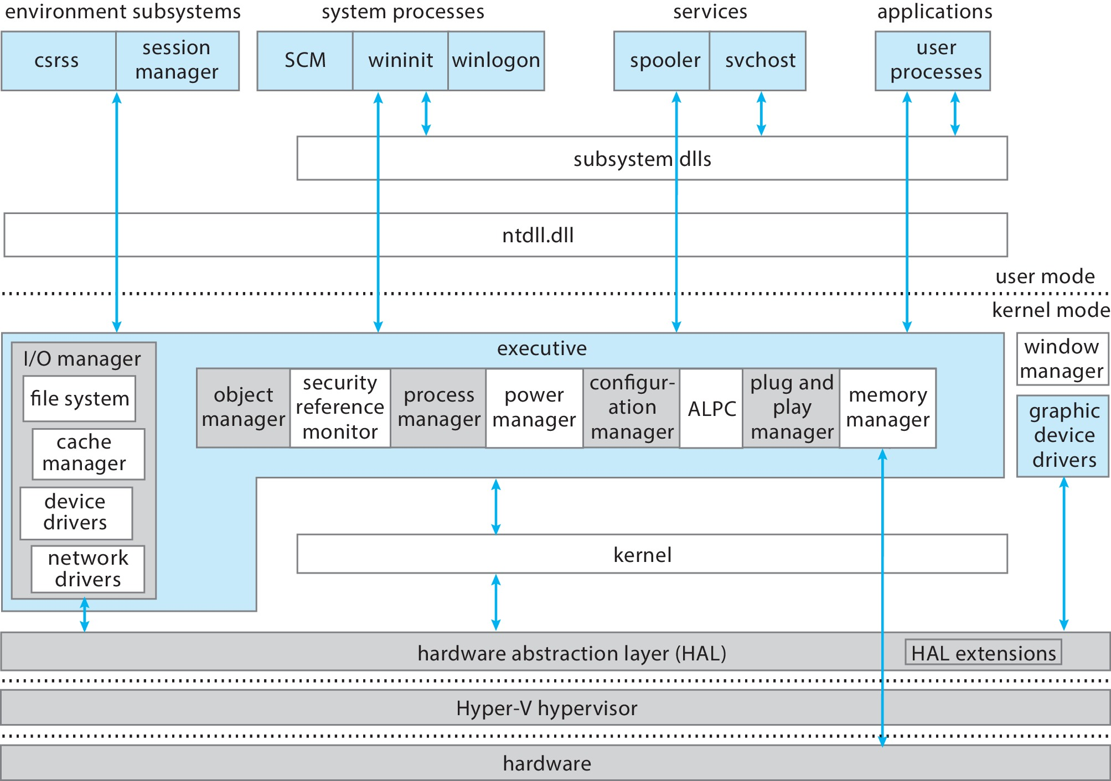
Depiction of 10 Architecture

Slide 11
System Components
Layered system of modules operating at specific privilege layers
Kernel and user mode of course
Virtual Trust Levels (VTLs) option implemented by Hyper-V virtualization
Enables virtual secure mode
Normal World (VTL 0) and Secure World (VTL 1)
Within each world are user and kernel modes
Secure world has a secure kernel and executive and a collection of trustlets
Bottommost layer runs in special processor mode (VMX Root Mode on Intel) including Hyper-V hypervisor, creating hardware-based normal-to-secure-world boundary

Slide 12
System Components — Kernel
Foundation for the executive and the subsystems
Never paged out of memory; execution is never preempted
Four main responsibilities:
thread scheduling
interrupt and exception handling
low-level processor synchronization
recovery after a power failure
Kernel is object-oriented, uses two sets of objects
dispatcher objects control dispatching and synchronization (events, mutants, mutexes, semaphores, threads and timers)
control objects (asynchronous procedure calls, interrupts, power notify, power status, process and profile objects)
VSM Enclaves allow valid signed third-party code to perform crypto calculations

Slide 13
Kernel — Process and Threads
The process has a virtual memory address space, information (such as a base priority), and an affinity for one or more processors
Threads are the unit of execution scheduled by the kernel’s dispatcher
Each thread has its own state, including a priority, processor affinity, and accounting information
A thread can be one of eight states: initializing, ready, deferred-ready, standby, running, waiting, transition, and terminated
Each thread has two modes of execution: user-mode thread (UT) and kernel-mode thread (KT)
Each has two stacks, one for each mode
Kernel layer runs trap handler to switch stacks and change CPU mode

Slide 14
Kernel — Scheduling
The dispatcher uses a 32-level priority scheme to determine the order of thread execution.
Priorities are divided into two classes
The real-time class contains threads with priorities ranging from 16 to 31
The variable class contains threads having priorities from 0 to 15
Characteristics of Windows 10’s priority strategy
Trends to give very good response times to interactive threads that are using the mouse and windows
Enables I/O-bound threads to keep the I/O devices busy
Complete-bound threads soak up the spare CPU cycles in the background

Slide 15
Kernel — Scheduling (Cont.)
Scheduling can occur when a thread enters the ready or wait state, when a thread terminates, or when an application changes a thread’s priority or processor affinity
Real-time threads are given preferential access to the CPU; but 10 does not guarantee that a real-time thread will start to execute within any particular time limit
This is known as soft realtime

Slide 16
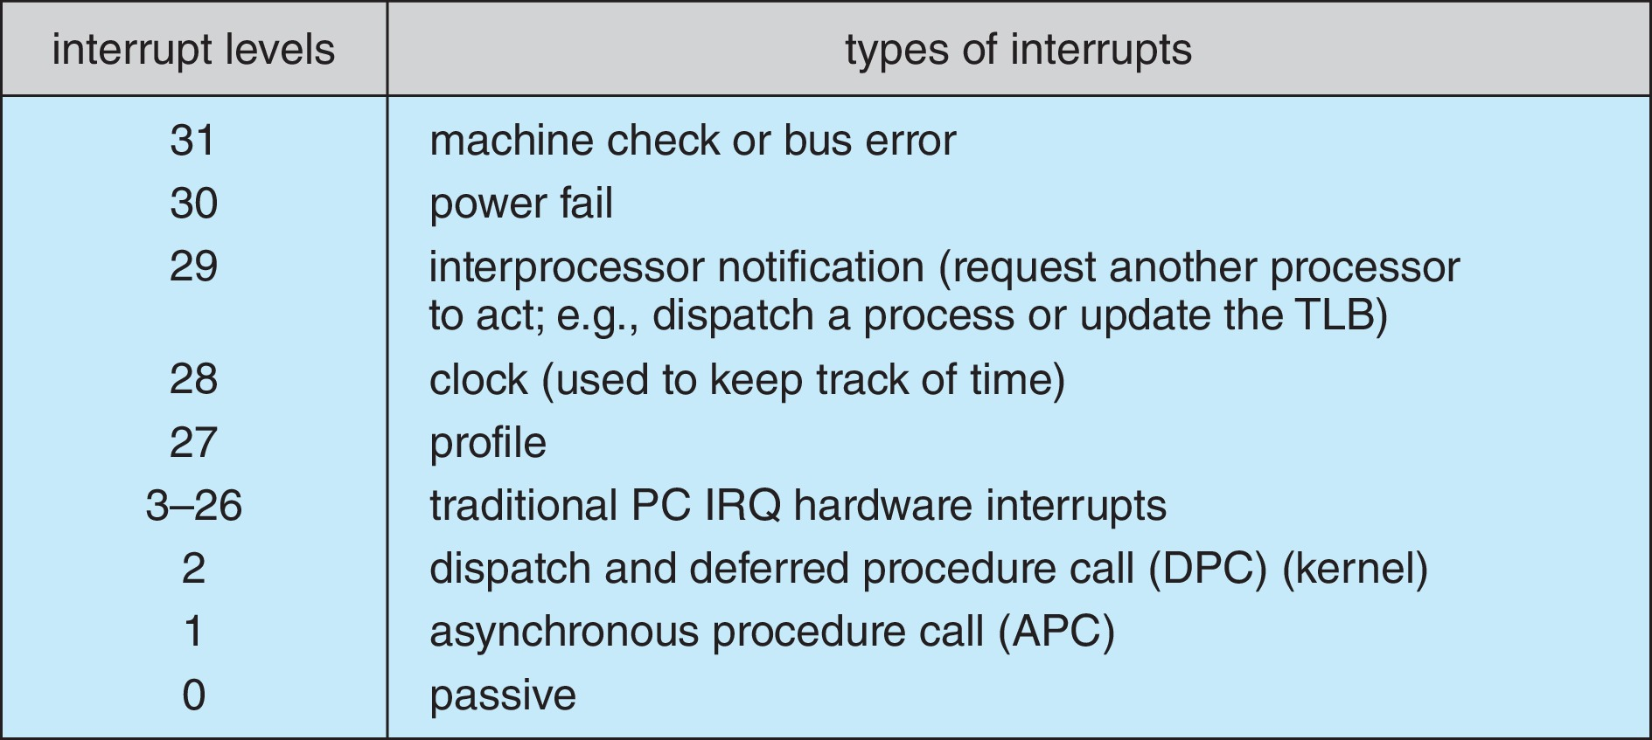
Windows x86 Interrupt Request Levels

Slide 17
Kernel — Trap Handling
The kernel provides trap handling when exceptions and interrupts are generated by hardware of software
Exceptions that cannot be handled by the trap handler are handled by the kernel's exception dispatcher
The interrupt dispatcher in the kernel handles interrupts by calling either an interrupt service routine (such as in a device driver) or an internal kernel routine
The kernel uses spin locks that reside in global memory to achieve multiprocessor mutual exclusion

Slide 18
Executive — Object Manager
Windows 7 uses objects for all its services and entities; the object manger supervises the use of all the objects
Generates an object handle
Checks security
Keeps track of which processes are using each object
Objects are manipulated by a standard set of methods, namely create, open, close, delete, query name, parse and security.

Slide 19
Executive — Naming Objects
The Windows 7 executive allows almost any object to be given a name, which may be either permanent or temporary
Exceptions are process, thread and some others object types
Object names are structured like file path names in MS-DOS and UNIX
Windows 7 implements a symbolic link object, which is similar to symbolic links in UNIX that allow multiple nicknames or aliases to refer to the same file
A process gets an object handle by creating an object by opening an existing one, by receiving a duplicated handle from another process, or by inheriting a handle from a parent process
Each object is protected by an access control list

Slide 20
Executive — Virtual Memory Manager
The design of the VM manager assumes that the underlying hardware supports virtual to physical mapping a paging mechanism, transparent cache coherence on multiprocessor systems, and virtual addressing aliasing.
The VM manager in Windows 10 uses a page-based management scheme with a whatever page sizes are supported by hardware (4 KB, 2MB, 1GB)
The Windows 10 VM manager uses a two-step process to allocate memory
The first step reserves a portion of the process’s address space
The second step commits the allocation by assigning space in the system’s paging file(s)

Slide 21
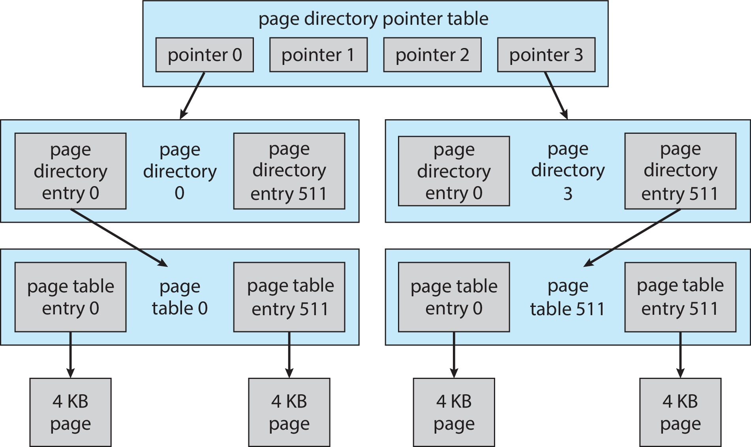
Virtual-Memory Layout

Slide 22
Virtual Memory Manager (Cont.)
The virtual address translation in Windows 10 uses several data structures
Each process has a page directory that contains 1024 page directory entries of size 4 bytes
Each page directory entry points to a page table which contains 1024 page table entries (PTEs) of size 4 bytes
Each PTE points to a 4 KB page frame in physical memory
A 10-bit integer can represent all the values form 0 to 1023, therefore, can select any entry in the page directory, or in a page table
This property is used when translating a virtual address pointer to a bye address in physical memory
A page can be in one of six states: valid, zeroed, free standby, modified and bad

Slide 23
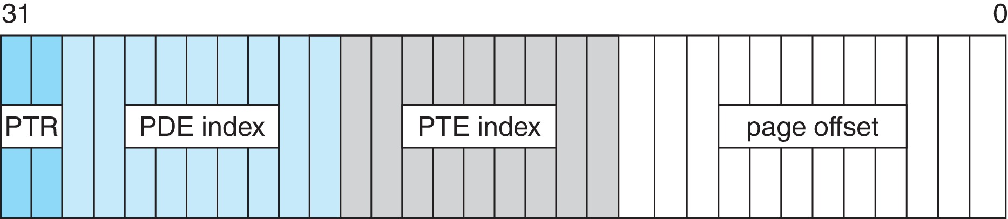
Virtual-to-Physical Address Translation on IA-32
2 bits index into four PDEs, 9 bits for page directory entry, 9 bits for page table entry, and 12 bits for byte offset in page

Slide 24
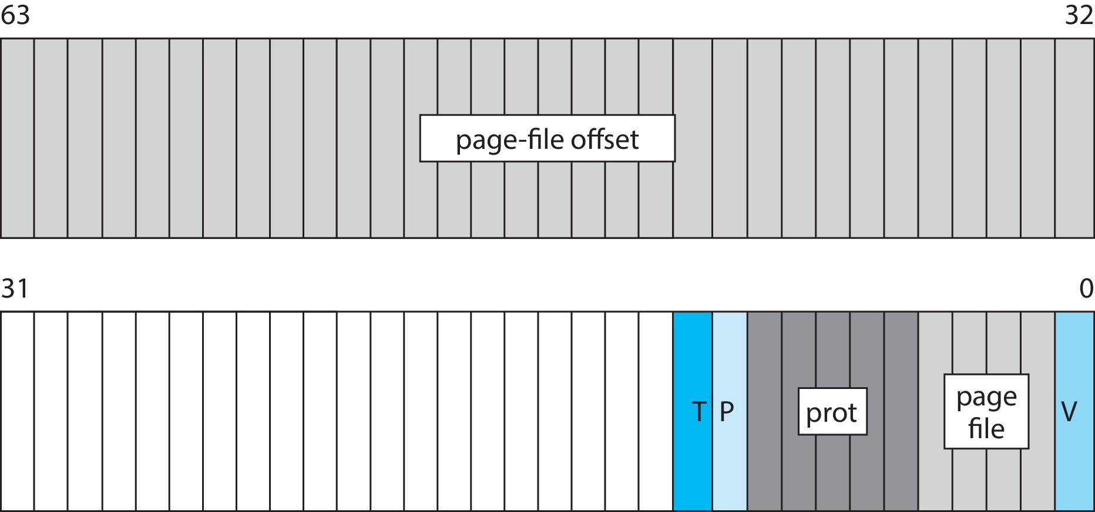
Page File Page-Table Entry
V=0, T=0, P=0
5 bits for page protection, 32 bits for page-file offset, frame address, 4 bits to select a paging file, and 20 bits for additional bookkeeping

Slide 25
Executive — Process Manager
Provides services for creating, deleting, and using threads and processes
Issues such as parent/child relationships or process hierarchies are left to the particular environmental subsystem that owns the process
Processes represented by job object
Docker container support via job objects called silos

Slide 26
Executive — Local Procedure Call Facility
The LPC passes requests and results between client and server processes within a single machine
When a LPC channel is created, one of three types of message passing techniques must be specified
First type is suitable for small messages, up to 256 bytes; port's message queue is used as intermediate storage, and the messages are copied from one process to the other
Second type avoids copying large messages by pointing to a shared memory section object created for the channel
Third method, called quick LPC was used by graphical display portions of the Win32 subsystem

Slide 27
Executive — I/O Manager
The I/O manager is responsible for
file systems
cache management
device drivers
network drivers
Keeps track of which installable file systems are loaded, and manages buffers for I/O requests
Works with VM Manager to provide memory-mapped file I/O
Controls the Windows 10 cache manager, which handles caching for the entire I/O system
Supports both synchronous and asynchronous operations, provides time outs for drivers, and has mechanisms for one driver to call another

Slide 28
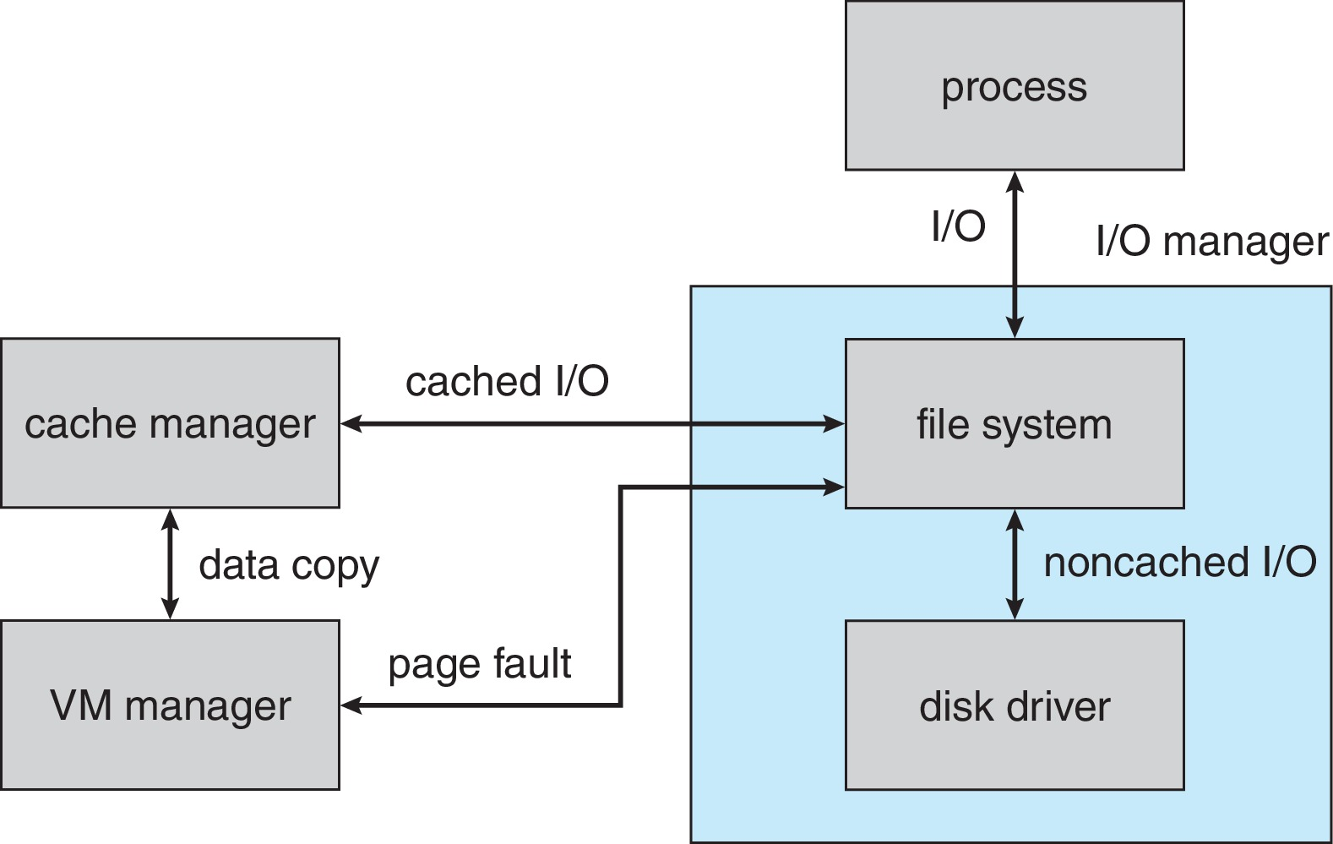
File I/O

Slide 29
Executive — Security Reference Monitor
The object-oriented nature of Windows 10 enables the use of a uniform mechanism to perform runtime access validation and audit checks for every entity in the system
Whenever a process opens a handle to an object, the security reference monitor checks the process’s security token and the object’s access control list to see whether the process has the necessary rights

Slide 30
Executive – Plug-and-Play Manager
Plug-and-Play (PnP) manager is used to recognize and adapt to changes in the hardware configuration
When new devices are added (for example, PCI or USB), the PnP manager loads the appropriate driver
The manager also keeps track of the resources used by each device

Slide 31
Executive – Power Manager
Detects current power conditions
Puts system to sleep, hibernation
Processor power manager for core parking, CPU throttling and boosting, etc.
Device state management

Slide 32
Executive – Registry
Configuration information kept in internal repositories called hives
Managed by configuration manager called registry
Separate hives for system information, each user’s preferences, software information, security and boot options
Windows creates system restore point before making registry changes to be able to recover previous registry if something goes wrong

Slide 33
Executive – Booting
Windows starts booting via BIOS firmware
UEFI includes Secure Boot feature that provides integrity checking via digital signature verification of all firmware and boot-time components
Firmware does Power-on self-test (POST)
If machine is hibernating, state restored via winresume.efi program
Kernel initializes, starts several processes including idle, system process, secure system process and session manager subsystem (SMSS)

Slide 34
Environmental Subsystems
User-mode processes layered over the native Windows 7 executive services to enable 7 to run programs developed for other operating system.
Windows 7 uses the Win32 subsystem as the main operating environment; Win32 is used to start all processes.
It also provides all the keyboard, mouse and graphical display capabilities.
MS-DOS environment is provided by a Win32 application called the virtual dos machine (VDM), a user-mode process that is paged and dispatched like any other Windows 7 thread.

Slide 35
Environmental Subsystems (Cont.)
16-Bit Windows Environment:
Provided by a VDM that incorporates Windows on Windows
Provides the Windows 3.1 kernel routines and sub routines for window manager and GDI functions
The POSIX subsystem is designed to run POSIX applications following the POSIX.1 standard which is based on the UNIX model.

Slide 36
Environmental Subsystems (Cont.)
OS/2 subsystems runs OS/2 applications
Logon and Security Subsystems authenticates users logging on to Windows 7 systems
Users are required to have account names and passwords.
The authentication package authenticates users whenever they attempt to access an object in the system.
Windows 7 uses Kerberos as the default authentication package

Slide 37
File System
The fundamental structure of the Windows 10 file system (NTFS) is a volume
Created by the Windows 10 disk administrator utility
Based on a logical disk partition
May occupy a portions of a disk, an entire disk, or span across several disks
All metadata, such as information about the volume, is stored in a regular file
NTFS uses clusters as the underlying unit of disk allocation
A cluster is a number of disk sectors that is a power of two
Because the cluster size is smaller than for the 16-bit FAT file system, the amount of internal fragmentation is reduced

Slide 38
File System — Internal Layout
NTFS uses logical cluster numbers (LCNs) as disk addresses
A file in NTFS is not a simple byte stream, as in MS-DOS or UNIX, rather, it is a structured object consisting of attributes
Every file in NTFS is described by one or more records in an array stored in a special file called the Master File Table (MFT)
Each file on an NTFS volume has a unique ID called a file reference
64-bit quantity that consists of a 48-bit file number and a 16-bit sequence number
Can be used to perform internal consistency checks
The NTFS name space is organized by a hierarchy of directories; the index root contains the top level of the B+ tree

Slide 39
File System — Recovery
All file system data structure updates are performed inside transactions that are logged
Before a data structure is altered, the transaction writes a log record that contains redo and undo information
After the data structure has been changed, a commit record is written to the log to signify that the transaction succeeded
After a crash, the file system data structures can be restored to a consistent state by processing the log records

Slide 40
File System — Recovery (Cont.)
This scheme does not guarantee that all the user file data can be recovered after a crash, just that the file system data structures (the metadata files) are undamaged and reflect some consistent state prior to the crash.
The log is stored in the third metadata file at the beginning of the volume.
The logging functionality is provided by the Windows 7 log file service.

Slide 41
File System — Security
Security of an NTFS volume is derived from the Windows 7 object model
Each file object has a security descriptor attribute stored in this MFT record
This attribute contains the access token of the owner of the file, and an access control list that states the access privileges that are granted to each user that has access to the file

Slide 42
Volume Management and Fault Tolerance
FtDisk, the fault tolerant disk driver for Windows 7, provides several ways to combine multiple SCSI disk drives into one logical volume
Logically concatenate multiple disks to form a large logical volume, a volume set
Interleave multiple physical partitions in round-robin fashion to form a stripe set (also called RAID level 0, or “disk striping”)
Variation: stripe set with parity, or RAID level 5
Disk mirroring, or RAID level 1, is a robust scheme that uses a mirror set — two equally sized partitions on tow disks with identical data contents
To deal with disk sectors that go bad, FtDisk, uses a hardware technique called sector sparing and NTFS uses a software technique called cluster remapping

Slide 43
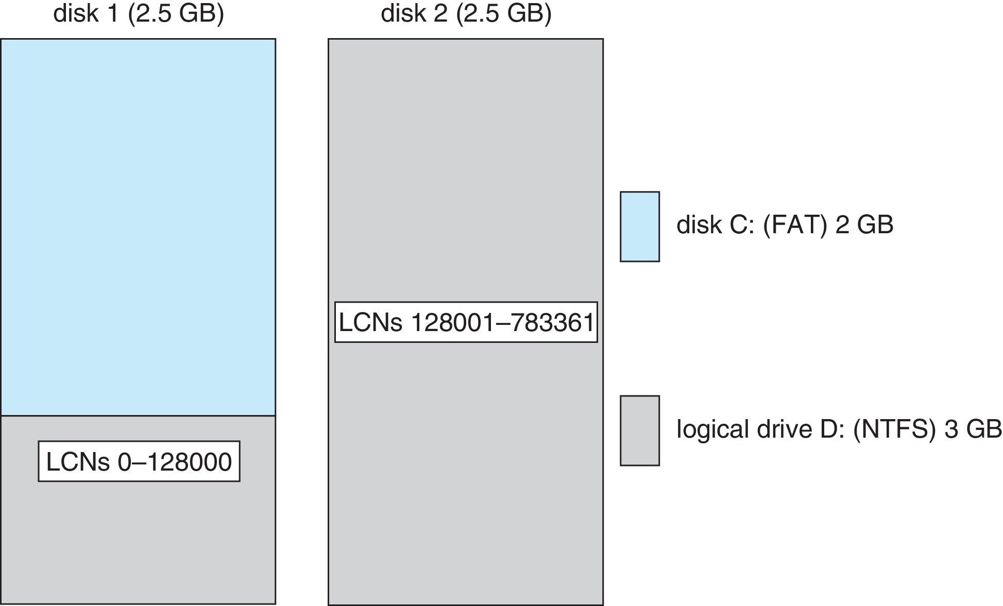
Volume Set On Two Drives

Slide 44
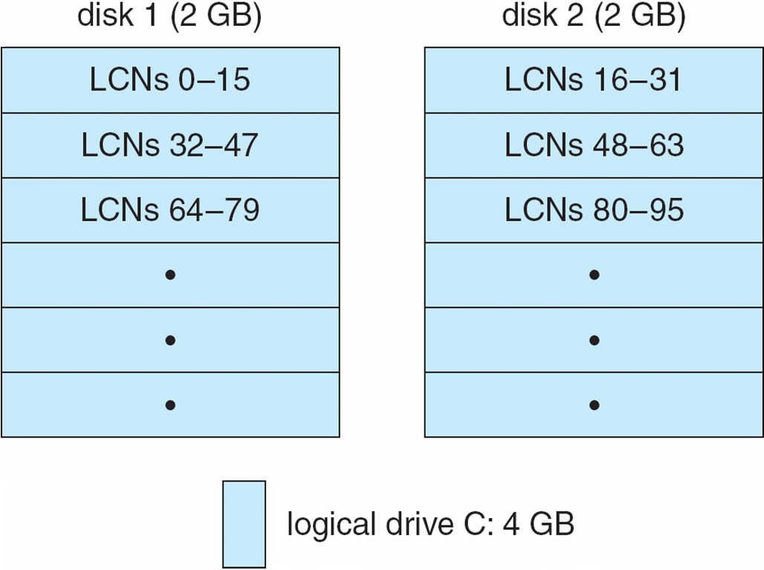
Stripe Set on Two Drives

Slide 45
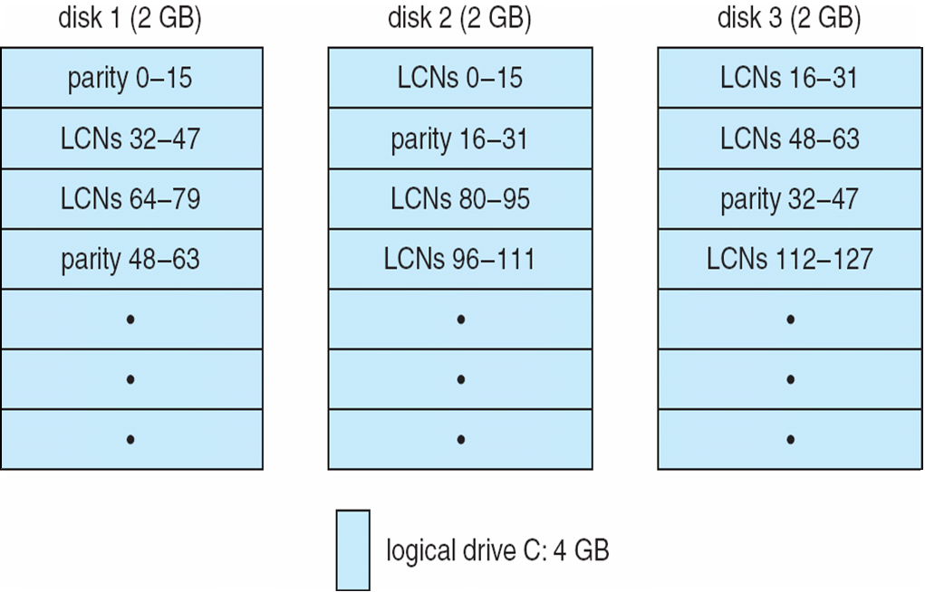
Stripe Set With Parity on Three Drives

Slide 46
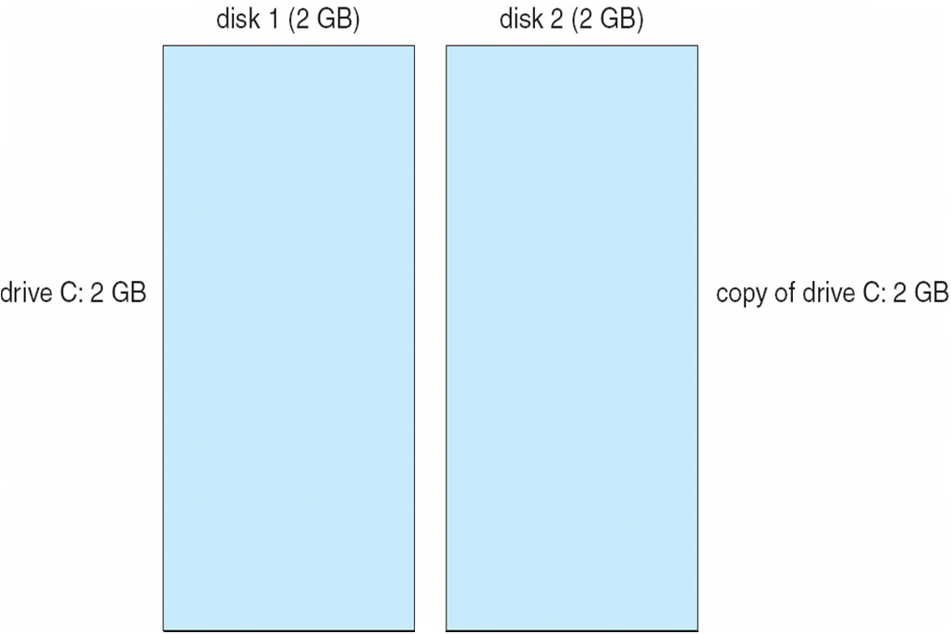
Mirror Set on Two Drives

Slide 47
File System — Compression
To compress a file, NTFS divides the file’s data into compression units, which are blocks of 16 contiguous clusters
For sparse files, NTFS uses another technique to save space
Clusters that contain all zeros are not actually allocated or stored on disk
Instead, gaps are left in the sequence of virtual cluster numbers stored in the MFT entry for the file
When reading a file, if a gap in the virtual cluster numbers is found, NTFS just zero-fills that portion of the caller’s buffer

Slide 48
File System — Reparse Points
A reparse point returns an error code when accessed
The reparse data tells the I/O manager what to do next
Reparse points can be used to provide the functionality of UNIX mounts
Reparse points can also be used to access files that have been moved to offline storage

Slide 49
Networking
Windows 10 supports both peer-to-peer and client/server networking; it also has facilities for network management
To describe networking in Windows 10, we refer to two of the internal networking interfaces:
NDIS (Network Device Interface Specification) — Separates network adapters from the transport protocols so that either can be changed without affecting the other
TDI (Transport Driver Interface) — Enables any session layer component to use any available transport mechanism
Windows 7 implements transport protocols as drivers that can be loaded and unloaded from the system dynamically

Slide 50
Networking — Protocols
The server message block (SMB) protocol is used to send I/O requests over the network. It has four message types:
Session control
File
Printer
Message
The network basic Input/Output system (NetBIOS) is a hardware abstraction interface for networks
Used to:
Establish logical names on the network
Establish logical connections of sessions between two logical names on the network
Support reliable data transfer for a session via NetBIOS requests or SMBs

Slide 51
Networking — Protocols (Cont.)
Windows uses the TCP/IP Internet protocol version 4 and version 6 to connect to a wide variety of operating systems and hardware platforms
PPTP (Point-to-Point Tunneling Protocol) is used to communicate between Remote Access Server modules running on Windows machines that are connected over the Internet
The Data Link Control protocol (DLC) is used to access IBM mainframes and HP printers that are directly connected to the network (possible on 32-bit only versions using unsigned drivers)

Slide 52
Networking — Distributed Processing Mechanisms
Windows 7 supports distributed applications via named NetBIOS, named pipes and mailslots, Windows Sockets, Remote Procedure Calls (RPC), and Network Dynamic Data Exchange (NetDDE)
NetBIOS applications can communicate over the network using TCP/IP
Named pipes are connection-oriented messaging mechanism that are named via the uniform naming convention (UNC)
Mailslots are a connectionless messaging mechanism that are used for broadcast applications, such as for finding components on the network
Winsock, the windows sockets API, is a session-layer interface that provides a standardized interface to many transport protocols that may have different addressing schemes

Slide 53
Distributed Processing Mechanisms (Cont.)
The Windows 7 RPC mechanism follows the widely-used Distributed Computing Environment standard for RPC messages, so programs written to use Windows 7 RPCs are very portable.
RPC messages are sent using NetBIOS, or Winsock on TCP/IP networks, or named pipes on LAN Manager networks.
Windows 7 provides the Microsoft Interface Definition Language to describe the remote procedure names, arguments, and results.

Slide 54
Networking — Redirectors and Servers
In Windows 7, an application can use the Windows 7 I/O API to access files from a remote computer as if they were local, provided that the remote computer is running an MS-NET server.
A redirector is the client-side object that forwards I/O requests to remote files, where they are satisfied by a server.
For performance and security, the redirectors and servers run in kernel mode.

Slide 55
Access to a Remote File
The application calls the I/O manager to request that a file be opened (we assume that the file name is in the standard UNC format)
The I/O manager builds an I/O request packet
The I/O manager recognizes that the access is for a remote file, and calls a driver called a Multiple Universal Naming Convention Provider (MUP)
The MUP sends the I/O request packet asynchronously to all registered redirectors
A redirector that can satisfy the request responds to the MUP
To avoid asking all the redirectors the same question in the future, the MUP uses a cache to remember with redirector can handle this file

Slide 56
Access to a Remote File (Cont.)
The redirector sends the network request to the remote system
The remote system network drivers receive the request and pass it to the server driver
The server driver hands the request to the proper local file system driver
The proper device driver is called to access the data
The results are returned to the server driver, which sends the data back to the requesting redirector

Slide 57
Networking — Domains
Windows uses the concept of a domain to manage global access rights within groups
A domain is a group of machines running Windows that share a common security policy and user database
Windows provides three models of setting up trust relationships
One way, A trusts B
Two way, transitive, A trusts B, B trusts C so A, B, C trust each other
Crosslink – allows authentication to bypass hierarchy to cut down on authentication traffic

Slide 58
Name Resolution in TCP/IP Networks
On an IP network, name resolution is the process of converting a computer name to an IP address
e.g., www.bell-labs.com resolves to 135.104.1.14
Windows provides several methods of name resolution:
Windows Internet Name Service (WINS)
broadcast name resolution
domain name system (DNS)
a host file
an LMHOSTS file
WINS consists of two or more WINS servers that maintain a dynamic database of name to IP address bindings, and client software to query the servers
WINS uses the Dynamic Host Configuration Protocol (DHCP), which automatically updates address configurations in the WINS database, without user or administrator intervention

Slide 59
Programmer Interface — Access to Kernel Object
A process gains access to a kernel object named XXX by calling the CreateXXX function to open a handle to XXX; the handle is unique to that process.
A handle can be closed by calling the CloseHandle function; the system may delete the object if the count of processes using the object drops to 0.
Windows provides three ways to share objects between processes
A child process inherits a handle to the object
One process gives the object a name when it is created and the second process opens that name
DuplicateHandle function:
Given a handle to process and the handle’s value a second process can get a handle to the same object, and thus share it

Slide 60
Programmer Interface — Process Management
Process is started via the CreateProcess routine which loads any dynamic link libraries that are used by the process, and creates a primary thread
Additional threads can be created by the CreateThread function
Every dynamic link library or executable file that is loaded into the address space of a process is identified by an instance handle

Slide 61
Process Management (Cont.)
Scheduling in Win32 utilizes four priority classes:
IDLE_PRIORITY_CLASS (priority level 4)
BELOW_NORMAL_PRIORITY CLASS (NT priority level 6)
NORMAL_PRIORITY_CLASS (level 8 — typical for most processes
ABOVE_NORMAL_PRIORITY_CLASS (level 10)
HIGH_PRIORITY_CLASS (level 13)
REALTIME_PRIORITY_CLASS (level 24)
To provide performance levels needed for interactive programs, Windows has a special scheduling rule for processes in the NORMAL_PRIORITY_CLASS
Distinguishes between the foreground process that is currently selected on the screen, and the background processes that are not currently selected
When a process moves into the foreground, increases the scheduling quantum by some factor, typically 3

Slide 62
Process Management (Cont.)
The kernel dynamically adjusts the priority of a thread depending on whether it is I/O-bound or CPU-bound
To synchronize the concurrent access to shared objects by threads, the kernel provides synchronization objects, such as semaphores and mutexes
In addition, threads can synchronize by using the WaitForSingleObject or WaitForMultipleObjects functions
Another method of synchronization in the Win32 API is the critical section

Slide 63
Process Management (Cont.)
A fiber is user-mode code that gets scheduled according to a user-defined scheduling algorithm
Only one fiber at a time is permitted to execute, even on multiprocessor hardware
Windows includes fibers to facilitate the porting of legacy UNIX applications that are written for a fiber execution model
Windows also introduced user-mode scheduling for 64-bit systems which allows finer grained control of scheduling work without requiring kernel transitions

Slide 64
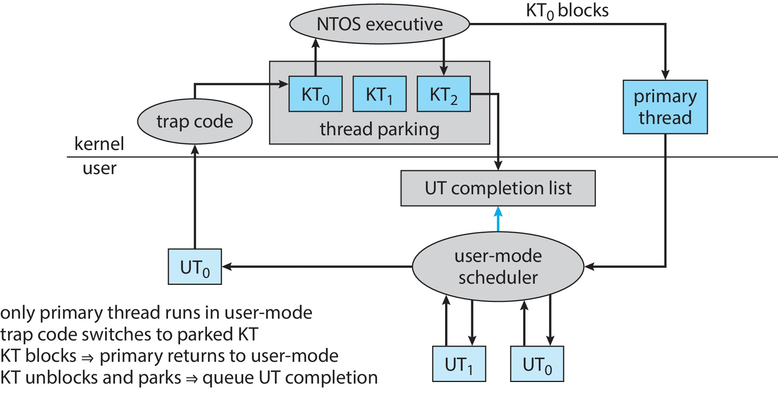
User-mode Scheduling

Slide 65
Programmer Interface — Interprocess Communication
Win32 applications can have interprocess communication by sharing kernel objects
An alternate means of interprocess communications is message passing, which is particularly popular for Windows GUI applications
One thread sends a message to another thread or to a window
A thread can also send data with the message
Every Win32 thread has its own input queue from which the thread receives messages
This is more reliable than the shared input queue of 16-bit windows, because with separate queues, one stuck application cannot block input to the other applications

Slide 66
Programmer Interface — Memory Management
Virtual memory:
VirtualAlloc reserves or commits virtual memory
VirtualFree decommits or releases the memory
These functions enable the application to determine the virtual address at which the memory is allocated
An application can use memory by memory mapping a file into its address space
Multistage process
Two processes share memory by mapping the same file into their virtual memory

Slide 67
Memory Management (Cont.)
A heap in the Win32 environment is a region of reserved address space
A Win 32 process is created with a 1 MB default heap
Access is synchronized to protect the heap’s space allocation data structures from damage by concurrent updates by multiple threads
Because functions that rely on global or static data typically fail to work properly in a multithreaded environment, the thread-local storage mechanism allocates global storage on a per-thread basis
The mechanism provides both dynamic and static methods of creating thread-local storage

Slide 68
End of Chapter 21

